Slide 1
Node01
Node02
docker
container1
container1
container1
docker
container2
container2
container3
container3
docker
google
kubernetes
k8s
Node01
Node02
container1
container1
container1
container2
container2
container3
container3

Slide 2
Master（Control） Node
Work Node
POD
POD
C1
POD
C1
C1
POD
C1
POD
POD
POD
C1
C1
C1
docker

Slide 3
docker google redhat
K8s API Server
Kubelet
Kubelet
Scheduler
Controller
Controller
Controller-Manager
Controller
Kubelet Proxy
Kubelet Proxy
etcd
flannel
flannel
flannel
Docker
Docker

Slide 4
Easy to use
The user should not have to run anything more than a couple of commands, including:
kubeadm init on the master
export KUBECONFIG=/etc/kubernetes/admin.conf
kubectl apply -f <network-of-choice.yaml>
kubeadm join --token <token> <master-ip>:<master-port>
The kubeadm join request to add a node should be automatically approved

Slide 5
用Kubeadm部署K8S Cluster
Kernel 3.10+
cgroups subsystem
warning] if Docker endpoint does not exist or does not work, if docker version >17.03
kubectl
kubeadm
kubeadm
kubeadm
kubelet
kubelet
kubelet
docker
docker
docker

Slide 6
3node （NAME="CentOS Linux"）
master node(controll node)
masnode1.example.com 192.168.0.100
work node
wornode1.example.com 192.168.0.101
wornode2.example.com 192.168.0.101
disable SELinux(optional)
disable firewalld(systemctl disable firewalld)
hosts文件（3node 解析）

Slide 7
https://kubernetes.io/docs/home/

Slide 8
Swap disabled.
You MUST disable swap in order for the kubelet to work properly
[root@masnode1 ~]# swapoff -a
[root@masnode1 ~]# vim /etc/fstab
#/dev/mapper/centos-swap swap swap defaults 0 0

Slide 9
Verify the MAC address and product_uuid are unique for every node
You can get the MAC address of the network interfaces using the command ip link or ifconfig -a
The product_uuid can be checked by using the command sudo cat /sys/class/dmi/id/product_uuid
[root@masnode1 ~]# ssh 192.168.0.101 cat /sys/class/dmi/id/product_uuid
5B474D56-EF47-F0F3-D21D-A4784281E58A
[root@masnode1 ~]# ssh 192.168.0.102 cat /sys/class/dmi/id/product_uuid
CBDD4D56-6514-D3B3-5A04-3EDA6373C56A
[root@masnode1 ~]# ssh 192.168.0.100 cat /sys/class/dmi/id/product_uuid
C7384D56-7A00-4A48-DA02-D46A53ED31D6

Slide 10
Check network adapters

Slide 11
Check required ports :Control-plane node(s)
Protocol Direction Port Range Purpose Used By
TCP Inbound 6443* Kubernetes API server All
TCP Inbound 2379-2380 etcd server client API kube-apiserver, etcd
TCP Inbound 10250 Kubelet API Self, Control plane
TCP Inbound 10251 kube-scheduler Self
TCP Inbound 10252 kube-controller-manager Self

Slide 12
Check required ports :work node(s)
Protocol Direction Port Range Purpose Used By
TCP Inbound 10250 Kubelet API Self, Control plane
TCP Inbound 30000-32767 NodePort Services** All

Slide 13
Installing runtime
Runtime Domain Socket
Docker /var/run/docker.sock
containerd /run/containerd/containerd.sock
CRI-O /var/run/crio/crio.sock
如果同时检测到Docker和containerd，则Docker优先。这是必需的，因为Docker 18.09附带了containerd，两者都是可检测的。如果检测到任何其他两个或更多运行时，kubeadm将退出并显示相应的错误消息

Slide 14
容器软件的设置
# Install Docker CE ## Set up the repository ### Install required packages. yum install yum-utils device-mapper-persistent-data lvm2 ### Add Docker repository. yum-config-manager \ --add-repo \ https://download.docker.com/linux/centos/docker-ce.repo ## Install Docker CE. yum update && yum install docker-ce-18.06.2.ce ## Create /etc/docker directory. mkdir /etc/docker # Setup daemon. cat > /etc/docker/daemon.json <<EOF { "registry-mirrors": ["https://wap3hkzj.mirror.aliyuncs.com"], "exec-opts": ["native.cgroupdriver=systemd"], "log-driver": "json-file", "log-opts": { "max-size": "100m" }, "storage-driver": "overlay2", "storage-opts": [ "overlay2.override_kernel_check=true" ] } EOF mkdir -p /etc/systemd/system/docker.service.d # Restart Docker systemctl daemon-reload systemctl restart docker
安装docker ce
更改设置，使容器运行时和kubelet systemd用作cgroup驱动程序，从而使系统稳定

Slide 15
安装kubeadm，kubelet和kubectl
kubeadm: the command to bootstrap the cluster.
kubelet: the component that runs on all of the machines in your cluster and does things like starting pods and containers.
kubectl: the command line util to talk to your cluster.
cat <<EOF > /etc/yum.repos.d/kubernetes.repo [kubernetes] name=Kubernetes baseurl=https://mirrors.aliyun.com/kubernetes/yum/repos/kubernetes-el7-x86_64 enabled=1 gpgcheck=0 EOF # Set SELinux in permissive mode (effectively disabling it) setenforce 0 sed -i 's/^SELINUX=enforcing$/SELINUX=disabled/' /etc/selinux/config yum install -y kubelet kubeadm kubectl --disableexcludes=kubernetes systemctl enable --now kubelet

Slide 16
traffic being routed incorrectly due to iptables being bypassed
Make sure that the br_netfilter module is loaded before this step. This can be done by running lsmod | grep br_netfilter.
To load it explicitly call modprobe br_netfilter.
cat <<EOF > /etc/sysctl.d/k8s.conf net.bridge.bridge-nf-call-ip6tables = 1 net.bridge.bridge-nf-call-iptables = 1 net.ipv4.ip_forward = 1 EOF sysctl --system

Slide 17
Creating a single control-plane cluster with kubeadm
Objectives
Install a single master Kubernetes cluster
kubeadm init <args>
[root@masnode1 ~]# kubeadm init --config kubeadm.yml
Install a Pod network on the cluster so that your Pods can talk to each other （flannel （quay.io--redhat））
For flannel to work correctly, you must pass --pod-network-cidr=10.244.0.0/16 to kubeadm init.

Slide 18
kubeadm.yml
kubeadm config print init-defaults > kubeadm.yml
advertiseAddress: 192.168.0.100
[root@masnode1 ~]# cat kubeadm.yml apiVersion: kubeadm.k8s.io/v1beta2 bootstrapTokens: - groups: - system:bootstrappers:kubeadm:default-node-token token: abcdef.0123456789abcdef ttl: 24h0m0s usages: - signing - authentication kind: InitConfiguration localAPIEndpoint: advertiseAddress: 192.168.0.100 bindPort: 6443 nodeRegistration: criSocket: /var/run/dockershim.sock name: wornode2.example.com taints: - effect: NoSchedule key: node-role.kubernetes.io/master --- apiServer: timeoutForControlPlane: 4m0s apiVersion: kubeadm.k8s.io/v1beta2 certificatesDir: /etc/kubernetes/pki clusterName: kubernetes controllerManager: {} dns: type: CoreDNS etcd: local: dataDir: /var/lib/etcd imageRepository: k8s.gcr.io kind: ClusterConfiguration kubernetesVersion: v1.15.0 networking: dnsDomain: cluster.local serviceSubnet: 10.96.0.0/12 podSubnet: 10.244.0.0/16 scheduler: {}
PodSubnet: 10.244.0.0/16

Slide 19
kubeadm init --config kubeadm.yml
（由于防火长城存在 访问不了k8s。gcr）下载为本地镜像 改名k8s。。。 参见P20
。。。。。
Your Kubernetes control-plane has initialized successfully!
To start using your cluster, you need to run the following as a regular user: 参见P21
mkdir -p $HOME/.kube
sudo cp -i /etc/kubernetes/admin.conf $HOME/.kube/config
sudo chown $(id -u):$(id -g) $HOME/.kube/config

Slide 20
docker pull registry.cn-shanghai.aliyuncs.com/fkfgw/kube-apiserver:v1.15.0
docker pull registry.cn-shanghai.aliyuncs.com/fkfgw/kube-controller-manager:v1.15.0
docker pull registry.cn-shanghai.aliyuncs.com/fkfgw/kube-scheduler:v1.15.0
docker pull registry.cn-shanghai.aliyuncs.com/fkfgw/kube-proxy:v1.15.0
docker pull registry.cn-shanghai.aliyuncs.com/fkfgw/pause:3.1
docker pull registry.cn-shanghai.aliyuncs.com/fkfgw/etcd:3.3.10
docker pull registry.cn-shanghai.aliyuncs.com/fkfgw/coredns:1.3.1
一共7个
docke tag registry.cn-shanghai.aliyuncs.com/fkfgw/coredns:1.3.1 k8s.gcr.io/coredns:1.3.1
。。。。。。。
[root@masnode1 ~]# docker image ls REPOSITORY TAG IMAGE ID CREATED SIZE k8s.gcr.io/kube-proxy v1.15.0 d235b23c3570 2 months ago 82.4MB k8s.gcr.io/kube-apiserver v1.15.0 201c7a840312 2 months ago 207MB k8s.gcr.io/kube-controller-manager v1.15.0 8328bb49b652 2 months ago 159MB k8s.gcr.io/kube-scheduler v1.15.0 2d3813851e87 2 months ago 81.1MB k8s.gcr.io/coredns 1.3.1 eb516548c180 8 months ago 40.3MB k8s.gcr.io/etcd 3.3.10 2c4adeb21b4f 9 months ago 258MB k8s.gcr.io/pause 3.1 da86e6ba6ca1 20 months ago 742kB

Slide 21
[root@masnode1 ~]# useradd -G wheel kubeadm
[root@masnode1 ~]# echo 1 |passwd --stdin kubeadm
su - kubeadm
mkdir -p $HOME/.kube
sudo cp -i /etc/kubernetes/admin.conf $HOME/.kube/config
sudo chown $(id -u):$(id -g) $HOME/.kube/config

Slide 22
Your Kubernetes control-plane has initialized successfully! To start using your cluster, you need to run the following as a regular user: mkdir -p $HOME/.kube sudo cp -i /etc/kubernetes/admin.conf $HOME/.kube/config sudo chown $(id -u):$(id -g) $HOME/.kube/config You should now deploy a pod network to the cluster. Run "kubectl apply -f [podnetwork].yaml" with one of the options listed at: https://kubernetes.io/docs/concepts/cluster-administration/addons/ Then you can join any number of worker nodes by running the following on each as root: kubeadm join 192.168.0.100:6443 --token abcdef.0123456789abcdef \ --discovery-token-ca-cert-hash sha256:c8cfab70a96f7546f86cf1c22f376e178f32dc57bbf6156faee150563ae642f5

Slide 23
https://github.com/coreos/flannel
看到
For Kubernetes v1.7+ kubectl apply -f https://raw.githubusercontent.com/coreos/flannel/master/Documentation/kube-flannel.yml
kubectl apply -f https://raw.githubusercontent.com/coreos/flannel/master/Documentation/kube-flannel.yml
或
kubectl apply -f /tmp/kube-flannel.yml
检查
kubectl get cs
kubectl get pod -n kube-system
[kubeadm@masnode1 ~]$ kubectl get pod -n kube-system NAME READY STATUS RESTARTS AGE coredns-5c98db65d4-4tprb 1/1 Running 0 3m6s coredns-5c98db65d4-8fp6r 1/1 Running 0 3m6s etcd-masnode1.example.com 1/1 Running 0 2m1s kube-apiserver-masnode1.example.com 1/1 Running 0 2m25s kube-controller-manager-masnode1.example.com 1/1 Running 0 2m25s kube-flannel-ds-amd64-h6647 1/1 Running 0 98s kube-proxy-bpgvv 1/1 Running 0 3m6s kube-scheduler-masnode1.example.com 1/1 Running 0 2m8s

Slide 25
Master
Node
Node
Node
API Server
kube-proxy
kube-proxy
kube-proxy
etcd
controller Manager
scheduler
kubelet
kubelet
kubelet
docker
docker
docker
docker
flannel
flannel
flannel
flannel

Slide 26
serviceSubnet: 10.96.0.0/12
podSubnet: 10.244.0.0/16
localAPIEndpoint:
advertiseAddress: 192.168.0.100

Slide 27
docker
kubelet
kubeproxy
API Server
kubectl
schedule
docker
kubelet
kubeproxy
docker
kubelet
kubeproxy

Slide 28
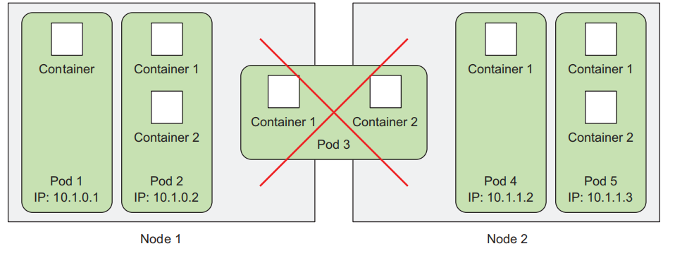

Slide 29
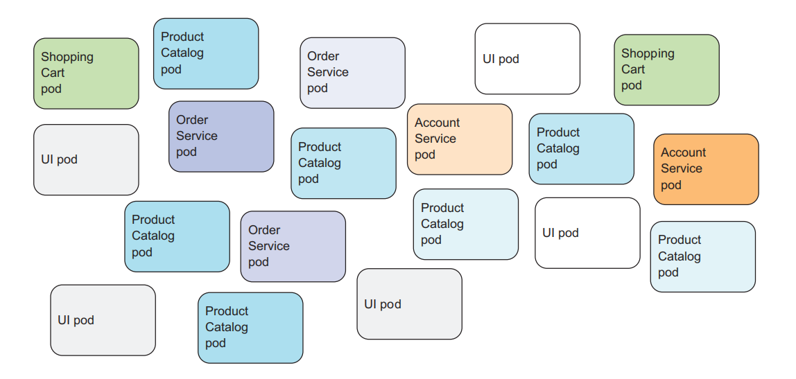

Slide 30
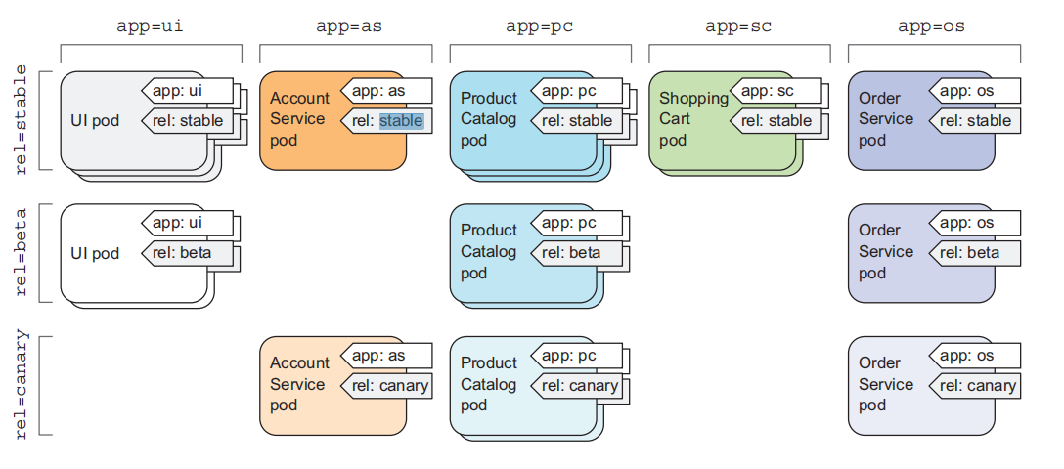

Slide 40
升级epel-releae；安装ansible（optional）（inventory文件 ssh互信.....）
安装docker-ce
下载ce yum源 （Day54）ansible all -m get_url -a 'url=https://download.docker.com/linux/centos/docker-ce.repo dest=/etc/yum.repos.d/'
yum list |grep docker-ce 查看源中docker版本
yum list docker-ce.x86_64 --showduplicates
all node 安装docker-ce;并启动和设置自动启动docker
ansible all -m yum -a 'name=docker-ce-18.09.7-3.el7 state=present'
ansible all -m service -a 'name=docker.service state=started enabled=yes'

Slide 41
安装Kubelet Kubeadm (master node kubectl)
源码 github （tar.gz）........
yum源 https://packages.cloud.google.com/yum/repos/kubernetes-el7-x86_64
yum镜像源: https://mirrors.aliyun.com/kubernetes/yum/repos/kubernetes-el7-x86_64/
yum-config-manager --add-repo=https://mirrors.aliyun.com/kubernetes/yum/repos/kubernetes-el7-x86_64/
[root@masnode1 ~]# yum install kubeamd kubelet kubectl
[root@masnode1 ~]# ssh 192.168.0.101 yum -y install kubeadm kubelet
[root@masnode1 ~]# ssh 192.168.0.102 yum -y install kubeadm kubelet

